Slide 1

UE19CS345 – Network Analysis and Mining
Course Project
Project Title : Graph Based Recommendation system for amazon products
Team member 1: Bhavikha Chopra
PES1UG19CS111
Team member 2: Gitika Jain
PES1UG19CS169
Team member 3: N. Mahendra
PES1UG19CS285
Team member 4: Snigdha Sinha
PES1UG19CS491

Slide 2
Topic and its uniqueness
Amazon Recommendation with Social Network Analysis based on co-purchase data: this method works well for all sorts of item groups in the dataset eg. Books, DVDs, Music CDs, etc
The advantage of this approach is that the graph needs to be built only once. After that, it’s very easy to add products to it by just adding the node and edges to other products. Also the search algorithm is the online feature and is fast in returning recommendations.

Slide 3
Dataset
The dataset contains product metadata and review information for about 548,552 different products. For each product the following information is available:
Product ID: numeric values (0,1,2….,548,551)
ASIN: Stands for Amazon Standard Identification Number is a 10-character alphanumeric UID assigned by Amazon for the identification of product.
Title: Name of the Product.
Group: Product type, could be books, music CDs, DVDs and VHS video tapes.

Slide 4
Dataset
SalesRank: Representation of the sales of that product compared to the others in its category.
Similar: ASINs of co-purchased products i.e., people who buy A also buy .
Categories: Gives the specification of the product’s category hierarchy, e.g., genre etc. (separated by |, category id in [ ]).
Reviews: Product’s review information will have Total Number of Reviews,Average Rating and individual customer review with time, user id, rating, total number of votes on the review and the number of people who found the review helpful.

Slide 5
Overall design or approach in a free hand diagram
Our Design consists of two parts:
Preprocessing
Recommendation

Slide 6
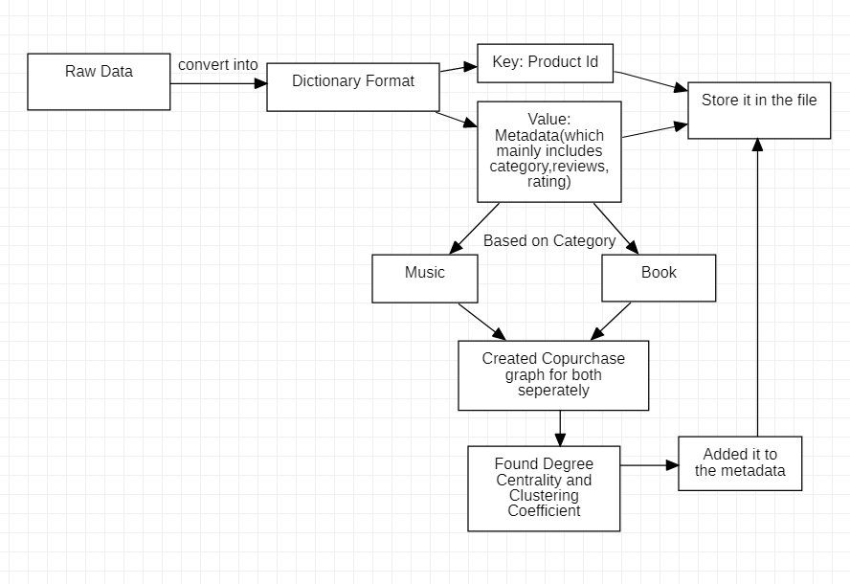
Overall design or approach in a free hand diagram
Preprocessing

Slide 7
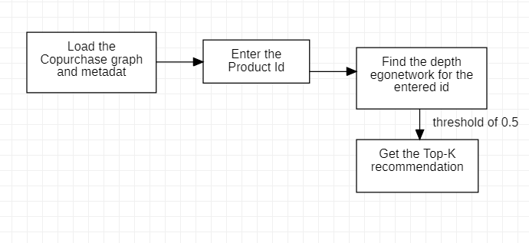
Overall design or approach in a free hand diagram
Recommendation

Slide 8
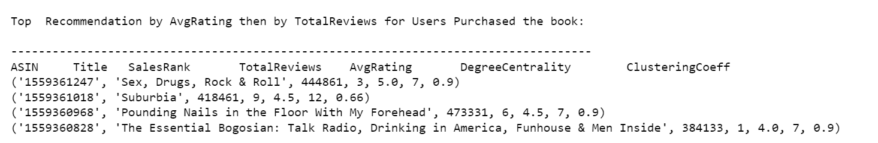
Final results
Output for book recommendation:

Slide 9
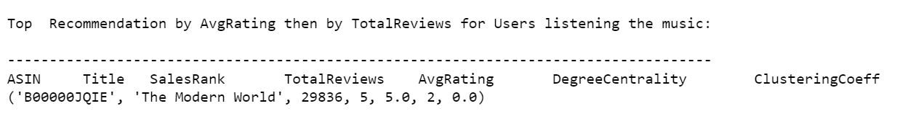
Final results
Output for music recommendation:
Our final result is a recommendation by combining 2 similarity metrics namely AvgRating and TotalReviews.

Slide 10
What are the remaining portions in this project ?
Given more time to work on the project, we had a few ideas to further implement. One of them is to perform NLP on the review text to extract sentiment from each review. We would attribute a score to how positive or negative a review is, which would help us in recommending better products.
We provided recommendations for amazon books and music and couldn’t do for other products because of lack of data.

Slide 11
Quantity and quality of work
no | Code functionality | % Complete | Runs without problem (Y/N) | If there are minor issues, indicate
1 | Separation of books from co-purchased list | 100 | Y | NO
2 | Plotted co-purchase graph for analysis. | 100 | Y | NO
3 | Adding degree centrality and clustering coefficients of each ASIN. | 100 | Y | NO
4 | To perform NLP on the review text to extract sentiment from each review. | 25 | N | The work is yet to be completed.
5 | Printing the top 5 recommendations using similarity metrics like avg rating and total reviews | 100 | Y | NO

Slide 12
Top few learning
Serial No | Top learning in this project
1 | Graph Based Recommendation
2 | Use of ego networks for analysis

Slide 13
Top unresolved challenges
Serial No | Brief description of unresolved challenges | Type of challenge (scope/data/design/implementation / others)
1 | Performing NLP on the review text to extract sentiment from each review. And having a score to how positive or negative a review is to recommend better products. | Scope
2 | Use of other similarity metrics for recommendation | implementation
3 | Providing recommendation for other amazon products. | Others - Our dataset had very less index on products like DVD because of which we couldn’t do recommendations on these products.

Slide 14
Reference papers, if any
No | Paper Title | Authors
1 | Graph-Based Recommendation of Amazon Products | Aaron Effron, Kelly Shen, Ryan Mui
2 | A graph-based recommender system for digital library | Zan Huang,Wingyan Chung,Hsiu-chin Chen
3 | Graph Based Web Recommendation System to Improve Time Efficiency | Shah Ankur , Varachhia Hemraj
4 | Graph based recommendation engine for Amazon products | Mohtadi Ben Fraj

Slide 15
THANK YOU

